Slide 1

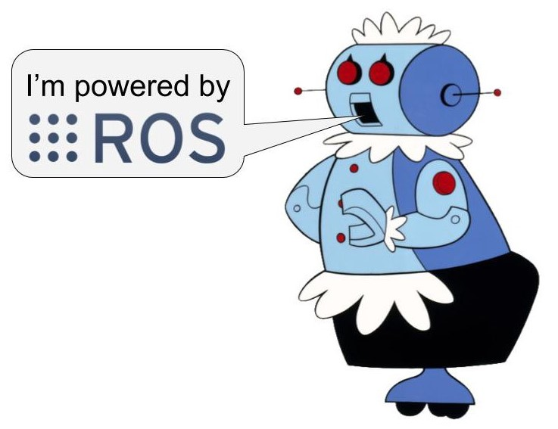
Introduction to the Robot Operating System (ROS): Main Concepts and Application Scenarios
Prakhar Rathi
[1]

Slide 2
Goals of the Seminar
Introduction of the topic.
Overview of the Robot Operating System (ROS).
Nomenclature of terms used in the ROS.
Philosophical design goals.
Use-cases of ROS.
AR/VR and Robotics.
Applications of ROS.
Conclusion
References.
Prakhar Rathi

Slide 3
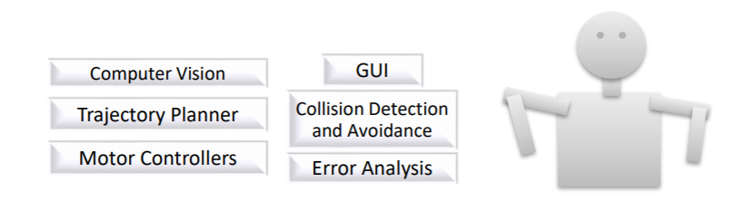
Introduction
Robot software systems execute a wide multitude of tasks (Figure 1).
Did you know that in CES 2020, Samsung unveiled a chef bot that could fix you up a plate of salad on your command [3]?
Requirements: Code-reuse, using feature-specific implementations from various sources, loose coupling, etc.
Fig. 1. Some fundamental tasks executed by a robot. [2]
Prakhar Rathi

Slide 4
Overview of the ROS
Robot:
  A computer programmed machine.
  Performs various tasks with speed and precision.
The Robot Operating System ( ROS ) [4]:
  A meta-operating System.
  Well equipped with most of the common features.
  Provides a common platform to practitioners across the globe.
  Allows integration of personal code with the generic code.
Prakhar Rathi

Slide 5
Overview of the ROS(continued...)
A comprehensive approach to understanding the ROS can be given as follows:
ROS = Plumbing + Tools + Capabilities + Ecosystem [5]
Plumbing: provides a message passing interface through a publish/subscribe infrastructure.
Tools: provides tools for debugging, introspection, visualization, testing, etc.
Capabilities: equipped with libraries to perform most of the robot functionalities.
Ecosystem: a large community across the globe.
Prakhar Rathi

Slide 6
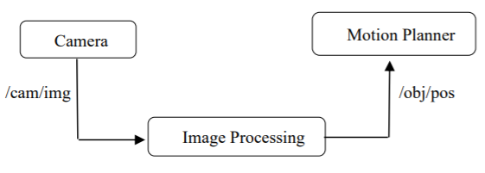

Nomenclature
Nodes (Figure 2):
  Specific feature, software modules.
  written using programming languages
  such as C++, Java, etc.
Publish/subscribe message passing:
  A communication infrastructure for topics (Figure 2).
Services (Figure 3):
  Request/response pair.
Fig. 2. Nodes and topics [2]
Fig. 3. Motion Planner requests a path from a service which then responds to the request [2]
Prakhar Rathi

Slide 7

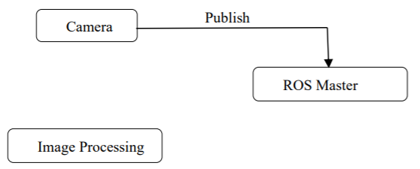
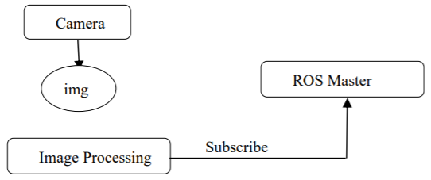
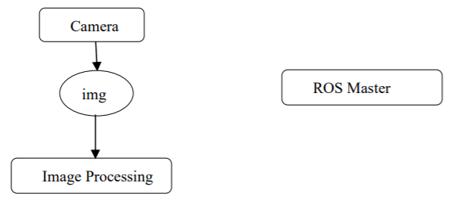
Nomenclature (continued…)
Messages (Figure 4).
Bags: store serialized messaging data for various ROS topics.
Master (Figure 5):
  Provides naming and registration services for nodes.
Fig. 4. Messages are sent on defined topics [2]
Fig. 5. Master plays an important role in inter-node communication by enabling nodes to lookup for other nodes that publish the required data [2]
Prakhar Rathi

Slide 8
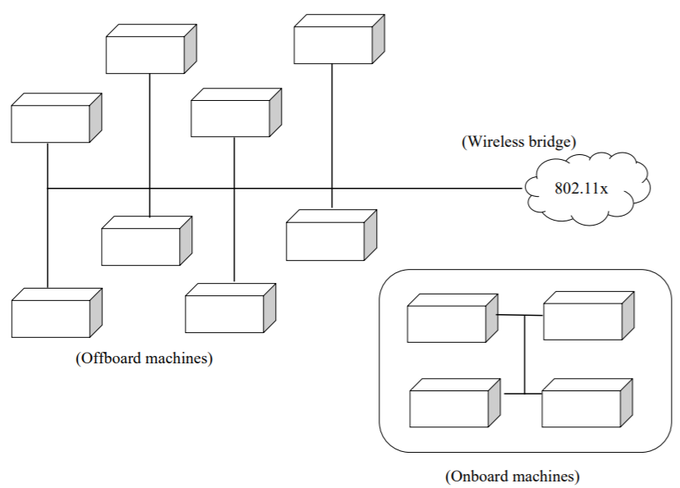
Philosophical Goals
Peer-to-peer messaging.
Tools-based software design: different tools for different processes.
Fig. 6. A typical ROS network configuration [4]
Prakhar Rathi

Slide 9
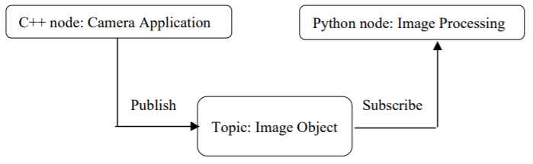
Philosophical Goals (continued…)
Multi-lingual.
Lightweight: drivers and algorithms compiled in stand-alone libraries [6].
Free and Open source.
Fig. 7. . Nodes interact despite being implemented using different programming languages. [2]
Prakhar Rathi

Slide 10
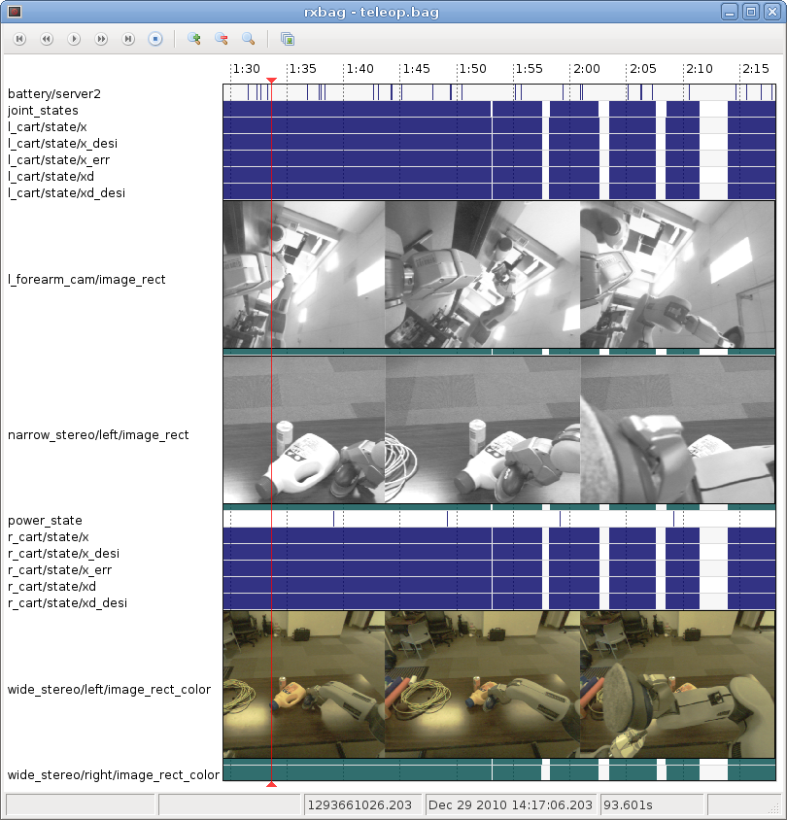
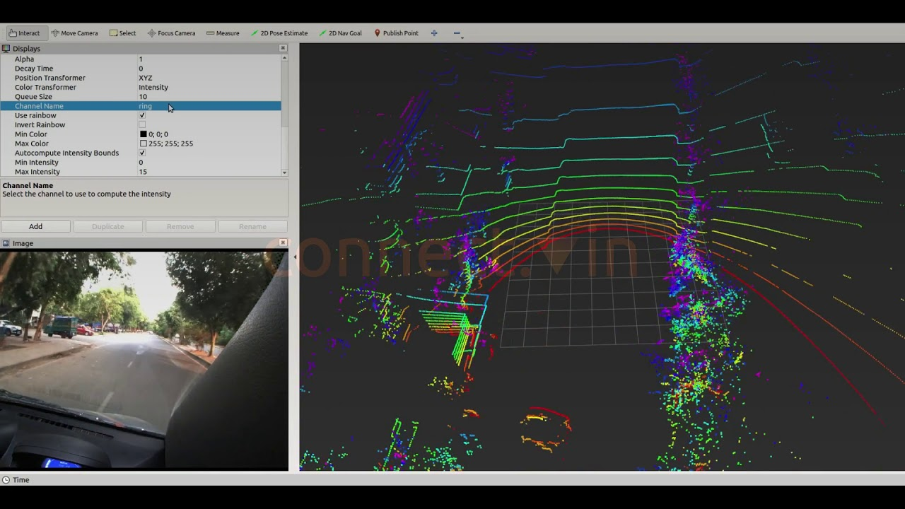
Use-Cases
Debugging a single node:
  Tools such as rostopic.
Logging data and playback:
  Test algorithms, perform comparisions etc.
Packaged subsystems.
Integrated development.
Visualization.
Transformations.
Fig. 8. Logging data by rosbag [7]
Fig. 9. visualizing the road using rviz [8]
Prakhar Rathi

Slide 11
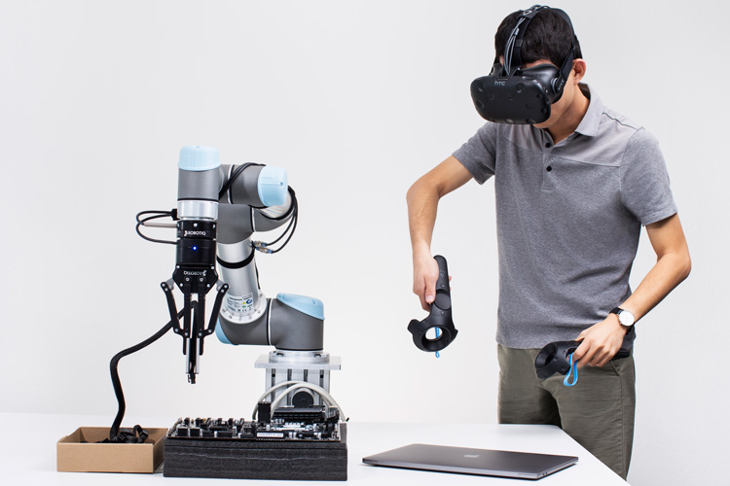
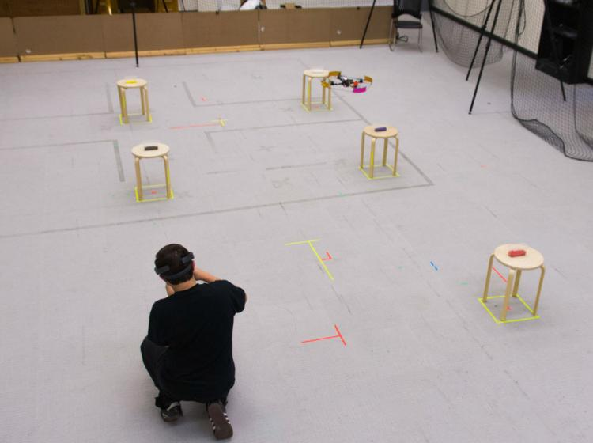
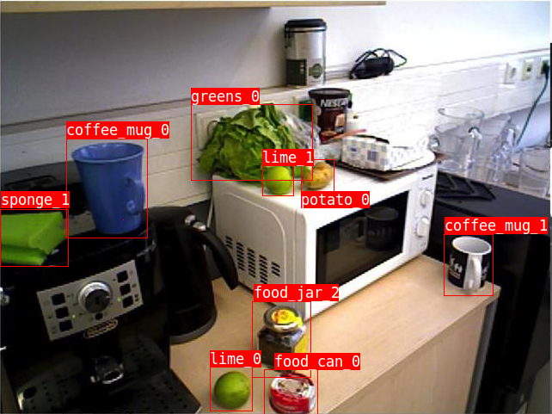
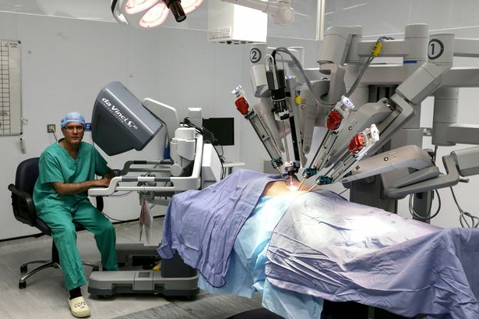
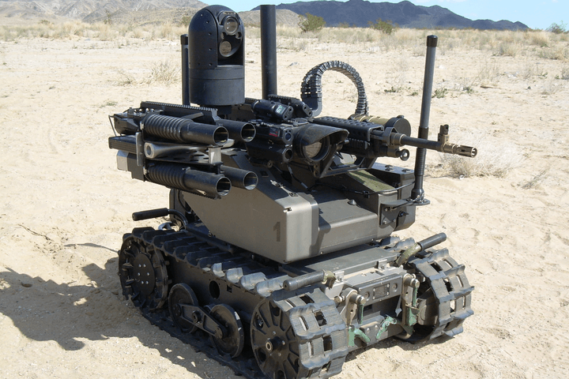
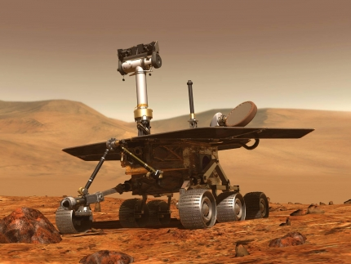
AR/VR and Robotics
Fig. 10. Robot Training [9]
Fig. 11. Human-robot interaction [10]
Fig. 12. Object identification [11]
Fig. 13. Healthcare [12]
Fig. 14. Military Robot [13]
Fig. 15. Space Exploration [14]
Prakhar Rathi

Slide 12
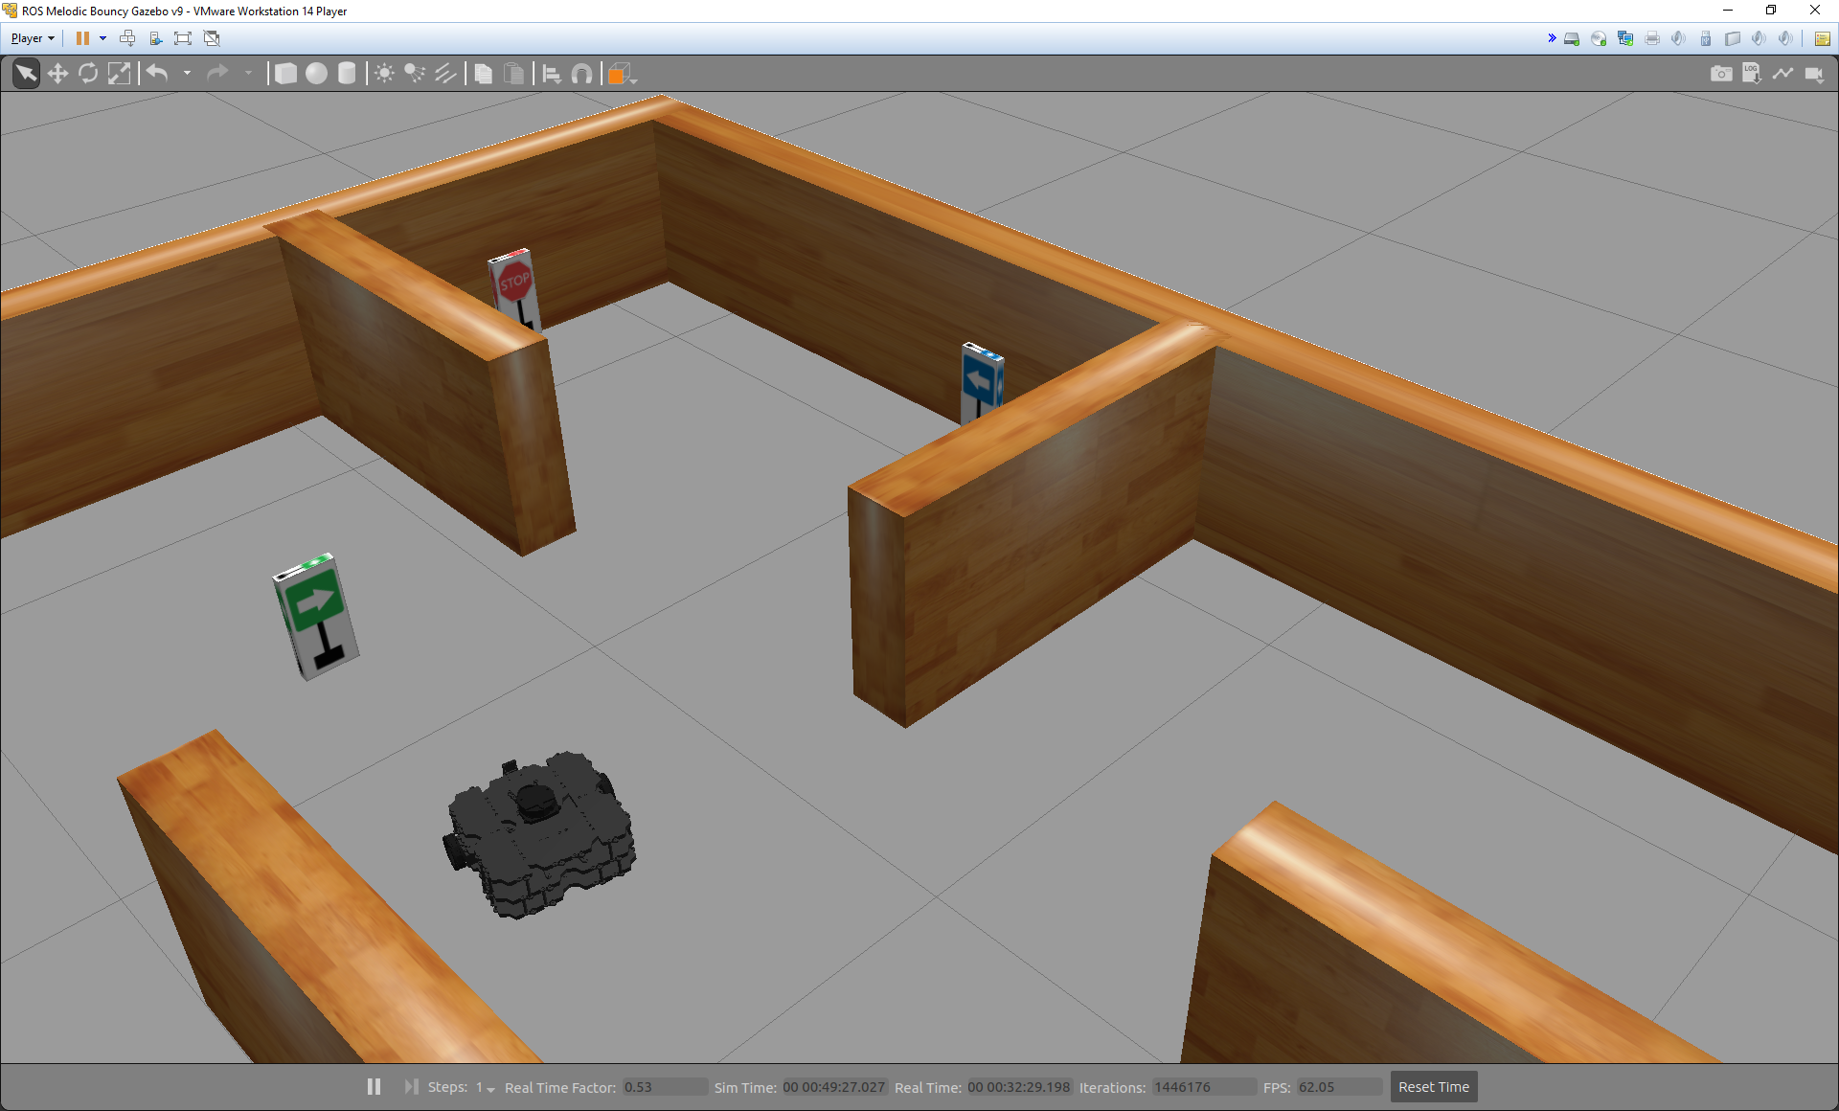
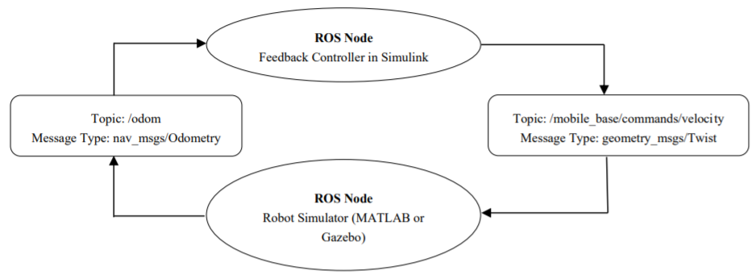
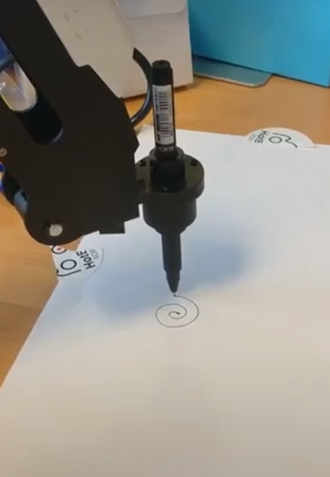
APPLICATIONS OF ROS
Fig. 17. Sending velocity commands [16].
Fig. 16. Sign-following robot [15].
Fig. 18. Manipulating Dobot
with ROS [17].
Prakhar Rathi

Slide 13
Conclusion
ROS is not a [6]:
  Programming language.
  IDE.
  Library.
ROS is a meta-operating system.
ROS can enhance robot software development due to its modular structure, multi-language support, and common platform, among other such features.
Future work: Utilizing the open source and free design of ROS to build innovative frameworks in various fields such as human-computer interaction.
Prakhar Rathi

Slide 14
References
Hadabot, 2018. 2 Exercises To Understand Robot Operating System Without Writing Any Code. Medium. https://medium.com/silicon-valley-robotics/2-exercises-to-understand-robot-operating-system-without-writing-any-code-c605133a82a0. Accessed 25 June 2020.
Mišeikis, J., 2018. INF3480 – Introduction to Robot Operating System [Lecture Notes]. https://www.uio.no/studier/emner/matnat/ifi/INF3480/v18/timeplan/lecturenotes/inf3480- part-a---ros---spring-2018---simplified.pdf.
Swider, M., 2020. Samsung CES 2020: the best thing at the booth is this salad-making Chef Bot. TechRadar India. https://www.techradar.com/in/news/samsungs-bot-chef-made-me-asalad-at-ces-2020-and-i-ate-it. Accessed 5 May 2020.
Quigley, M. et al., 2009: ROS: An open-source robot operating system. In: Workshops at the IEEE International Conference on Robotics and Automation.
Gerkey, B., 2011. What is ROS Exactly? Middleware, Framework, Operating System? – ROS Answers: Open Source Q&A Forum. Answers.ros.org. https://answers.ros.org/question/12230/what-is-ros-exactly-middleware-framework-operating-system/#18055. Accessed 7 May 2020.
O’Kane, J., 2014. A Gentle Introduction to ROS. Columbia, SC: Jason M. O’Kane.
Library.isr.ist.utl.pt., n.d. Rxbag. http://library.isr.ist.utl.pt/docs/roswiki/rxbag.html. Accessed 26 June 2020.
Prakhar Rathi

Slide 15
References (continued…)
Connect Vin, 2019. Visualizing 3D lidar data in ROS. In: Youtube. https://www.youtube.com/watch?v=BrOx619qYto. Accessed 26 June 2020.
Carlton, B., 2017. Training Robots Tedious Tasks With VR - Vrscout. VRScout. https://vrscout.com/news/training-robots-tedious-tasks-vr/. Accessed 26 June 2020.
ATLAS Institute. 2018. Augmented reality enhances robot collaboration. University of Colorado Boulder. https://www.colorado.edu/atlas/2018/03/15/augmented-reality-enhances-robot-collaboration. Accessed 30 May 2020.
Loghmani, M., Caputo, B., and Vincze, M., 2018. Recognizing Objects In-the-wild: Where Do We Stand?. In: IEEE International Conference on Robotics and Automation (ICRA).
IndiaFIRST® Robotics. n.d. Medical Robots | Robots For Surgery | Healthcare Robots. http://indiafirstrobotics.com/medical-robots. Accessed 26 June 2020.
Nicol, W., 2017. The 9 Coolest Military Robots | MAARS, DOGO, Etc.. Digital Trends. https://www.digitaltrends.com/cool-tech/coolest-military-robots. Accessed 29 June 2020.
NASA. n.d. Robotics Image Gallery. https://www.nasa.gov/audience/foreducators/robotics/imagegallery/index.html#lowerAccordion-set3-slide30. Accessed 29 June 2020.
Prakhar Rathi
Seminar Introduction to the Robot Operating System (ROS)

Slide 16
References (continued…)
In.mathworks.com. n.d. Sign Following Robot with ROS in MATLAB – MATLAB & Simulink – Mathworks India. https://in.mathworks.com/help/ros/ug/ros-sign-following.html. Accessed 19 June 2020.
In.mathworks.com. n.d. Feedback control of a ROS-Enabled Robot – MATLAB & Simulink – Mathworks India. https://in.mathworks.com/help/ros/ug/feedback-control-of-a-ros-enabled-robot.html. Accessed 14 June 2020.
Gabriele Ermacora, 2018. Dobot – ROS driver. In: Youtube. https://www.youtube.com/watch?time_continue=21&v=eXZgVXh3Phg&feature=emb_logo. Accessed 27 June 2020.
Prakhar Rathi
Seminar Introduction to the Robot Operating System (ROS)

Slide 17
Thank You for your Attention.
Prakhar Rathi

